Slide 1


Transport Layer I: roadmap
Transport Layer Overview
Transport Layer services & functions
Internet Transport Layer
Multiplexing/ De-multiplexing
Connectionless & connection-oriented
User Datagram Protocol – UDP
UDP features
UDP Checksum
Checksum calculation
Chapter 3

Slide 2
Transport Layer I: roadmap (cont.)
Principles of Reliable Data Transfer
TCP Overview
TCP segment structure
TCP sequence numbers
TCP timeout
TCP Reliable Data Transfer
TCP fast retransmit
TCP Flow Control
TCP Connection Management
3-way handshake
Chapter 3

Slide 3
Transport Layer II: roadmap
Principles of congestion control
TCP congestion control
Chapter 3

Slide 4








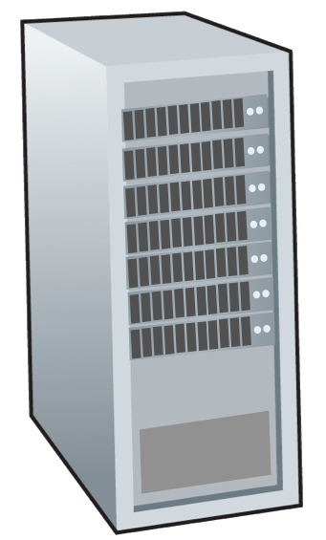







Transport services and protocols
application
transport
network
data link
physical
provide logical communication between application processes running on different hosts
mobile network
national or global ISP
transport protocols implemented in end systems not in routers:
sender: breaks application messages into segments, passes to network layer
receiver: reassembles segments into messages, passes to application layer
logical end-end transport
local or regional ISP
home network
content
provider
network
application
transport
network
data link
physical
datacenter
network
two transport protocols available to Internet applications
TCP, UDP
enterprise
network

Slide 5
Two principal transport-layer protocols
application
transport
network
data link
physical
TCP: Transmission Control Protocol
reliable, in-order delivery
congestion control
flow control
connection setup
UDP: User Datagram Protocol
unreliable, unordered delivery
no-frills extension of “best-effort” IP
mobile network
national or global ISP
logical end-end transport
local or regional ISP
home network
content
provider
network
application
transport
network
data link
physical
datacenter
network
enterprise
network

Slide 6
UDP checksum
Goal: detect errors (i.e., flipped bits) in transmitted segment
sender:
treat contents of UDP segment (including header fields) as sequence of 16-bit integers
checksum: addition (one’s complement sum) of segment content
checksum value put into UDP checksum field
receiver:
compute checksum of received segment
check if computed checksum equals checksum field value:
Not equal - error detected
Equal - no error detected. But maybe errors nonetheless?

Slide 7

Internet checksum: an example
example: checksum calculation for two 16-bit integers
1 1 1 0 0 1 1 0 0 1 1 0 0 1 1 0
1 1 0 1 0 1 0 1 0 1 0 1 0 1 0 1
wraparound
1 1 0 1 1 1 0 1 1 1 0 1 1 1 0 1 1
sum
1 0 1 1 1 0 1 1 1 0 1 1 1 1 0 0
checksum
0 1 0 0 0 1 0 0 0 1 0 0 0 0 1 1
1s complement to get the checksum
Checksum calculation steps:
Get the summation of the two 16-bit integers.
The overflow bit needs to be wrapped around (add the overflow bit and the last bit).
Use 1s complement to get the checksum (The 1s complement is obtained by converting all the 0s to 1s and converting all the 1s to 0s)

Slide 8
TCP: overview RFCs: 793,1122, 2018, 5681, 7323
point-to-point:
one sender, one receiver
reliable, in-order byte steam:
no “message boundaries"
full duplex data:
bi-directional data flow in same connection
MSS: maximum segment size
cumulative ACKs
pipelining:
TCP congestion and flow control set window size
connection-oriented:
handshaking (exchange of control messages) initializes sender, receiver state before data exchange
flow controlled:
sender will not overwhelm receiver

Slide 9


TCP fast retransmit
Host A
Host B
TCP fast retransmit
if sender receives 3 additional ACKs for same data (“triple duplicate ACKs”), resend unACKed segment with smallest seq #
likely that unACKed segment lost, so don’t wait for timeout
Seq=92, 8 bytes of data
Seq=100, 20 bytes of data
X
ACK=100
timeout
ACK=100
ACK=100
Receipt of three duplicate ACKs indicates 3 segments received after a missing segment – lost segment is likely. So retransmit!
ACK=100
Seq=100, 20 bytes of data

Slide 10
TCP flow control
application
process
Q: What happens if network layer delivers data faster than application layer removes data from socket buffers?
Application removing data from TCP socket buffers
TCP socket
receiver buffers
TCP
code
flow control
receiver controls sender, so sender won’t overflow receiver’s buffer by transmitting too much, too fast
IP
code
from sender
receiver protocol stack

Slide 11
TCP congestion control: AIMD
approach: senders can increase window size (and hence sending rate), probing for usable bandwidth until packet loss occurs
Additive Increase
Multiplicative Decrease
increase cwnd by 1 maximum segment size every RTT until loss detected
cut cwnd in half at each loss event
AIMD sawtooth
behavior: probing
for bandwidth
TCP sender Sending rate
time

Slide 12
TCP slow start
Host A
Host B
when connection begins, sending rate increased exponentially until first loss event or ssthresh is reached:
initially cwnd = 1 MSS
double cwnd every RTT
done by incrementing cwnd for every ACK received
one segment
RTT
two segments
four segments
summary: initial sending rate is slow, but ramps up exponentially fast
time

Slide 13
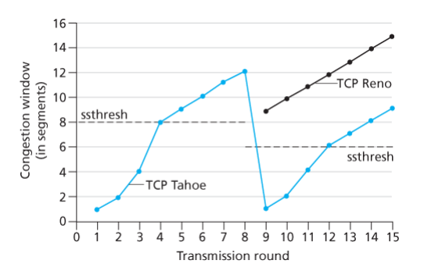

TCP: from slow start to congestion avoidance
Q: when should the exponential increase switch to linear?
A: when it reaches ssthresh
Three duplicate ACKs received
ssthresh
shorthand for “slow start threshold”
initially set to be a large value
When timeout event occurs, set it to 1/2 of cwnd before timeout
Congestion avoidance:
cwnd is additively increased by 1 MSS every RTT (as long as non-duplicate ACKs are received)
For timeout event: TCP Tahoe and TCP Reno will do the same changes for cwnd and ssthresh
For 3 duplicate ACKs, TCP Tahoe and TCP Reno will treat it differently

Slide 14
TCP Congestion Control - Summary
When cwnd is below ssthresh, sender in slowstart phase, window grows exponentially
When cwnd is above ssthresh, sender is in congestion-avoidance phase, window grows linearly
When timeout event occurs (for both Tahoe and Reno), cwnd is set to 1 MSS; ssthresh is set to half the congestion window size before the timeout; starts the slow start phase
When 3 duplicate ACKs are received
For TCP Tahoe, Fast Retransmit; sets cwnd to 1 MSS; set ssthresh to ½ cwnd when the three duplicate ACKs are received, starts the slow start phase
For TCP Reno, Fast Retransmit; set ssthresh equal to ½ cwnd when the three duplicate ACKs are received, set cwnd = ssthresh + 3*MSS, starts the fast recovery phase

